Slide 1
Past M&A Activities
Deals ranged from USD250m - USD1.5b for wind farm capacity of 300 - 600 MW
2019
2022
April
September
October
November
December
USD773m
USD320m
USD277m
USD1.5b
USD250m
NextEra Energy Partners acquired 391MW capacity wind farm from Brookfield Renewable.
Enbridge acquired wind and solar energy portfolio from Tri Global Energy.
InfraRed Capital acquired 49% stake in 551MW capacity wind farm from Algonquin.
NextEra Energy Partners acquired wind and solar energy portfolio from NextEra Energy Resources.
Boralex acquired 50% stake in 447MW capacity wind farm from EDF Renewables North America

Slide 2
Acquisition Evaluation Metrics Threshold
Plant capacity below 600 MW to keep within a more manageable investment budget
Cluster with higher uptime and consumption rate (blue cluster)
At least 5% compounded annual growth in uptime rate across plants
No increase in compounded annual consumption rate across plants

Slide 3
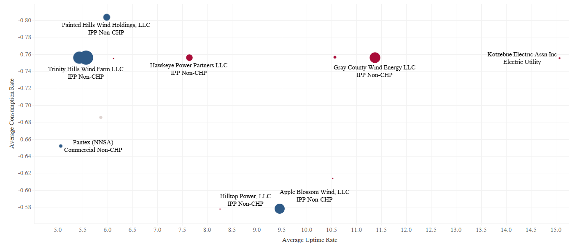
Partner companies are selected based on higher uptime rate and lower consumption rate
Targets based on Consumption Rate vs. Uptime Rate

Slide 4
Shortlisted targets ranked based on average uptime
Rank | Operator name | Owner | Total Farm Size (MW) | Average Uptime (MWh/MW) | Location
1 | FPL Energy Weatherford, LLC | Subsidiary of FPL Group, Inc | 147 | 4,235 | Oklahoma
2 | Trinity Hills Wind Farm LLC | Ares Management Corp. | 198 | 4,062 | Texas
3 | Pantex (NNSA) | Government owned (NNSA) | 12 | 3,773 | Texas
4 | Painted Hills Wind Holdings, LLC | Terra-Gen LLC (under PPA w Shell Energy) | 47 | 2,515 | California
5 | Apple Blossom Wind, LLC | AEP Renewables | 100 | 2,431 | Michigan

Slide 5
Potential roadmap through acquisition of operator
Exit in 5-10 years as the market grows
Repower older turbine through retrofitting (increase lifespan for ~5-10 years)
Plant expansion capitalising on operating management
Future establishment of hybrid farms

